Slide 1

RJA
Littleover Community School Sixth Form
New Parents’ Information Evening

Slide 2
The purpose of this evening
RJA
Ensure parents know what to expect
Teenagers not always the best at communicating with parents!
Ensure that we can all work together to maximise chances of success
Give you an opportunity to ask questions and encourage you to keep lines of communication open

Slide 3
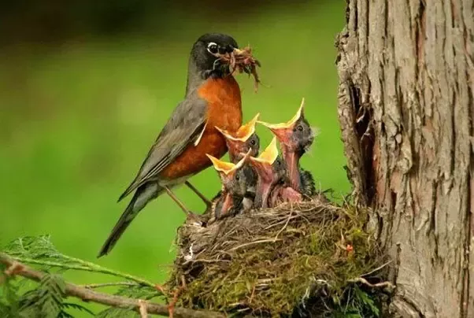
VAD
A Level vs GCSE Study

Slide 4
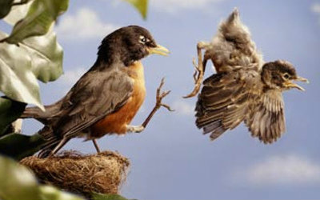
VAD
A Level vs GCSE Study

Slide 5
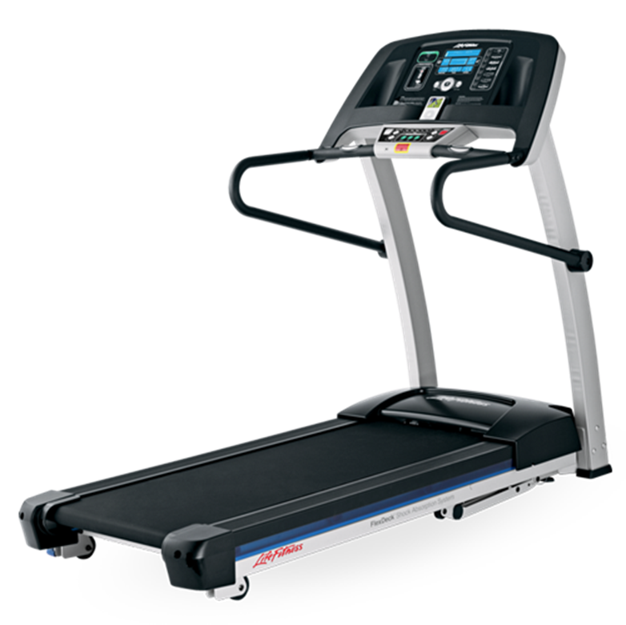
VAD
A Level vs GCSE Study

Slide 6
Studying A Levels
Hit the ground running
Expect it to be hard
Be proactive
Communicate with staff
Meet deadlines
Re-cap notes
VAD

Slide 7
Transition from GCSE to A level
VAD
MUCH harder (GCSE 6 grades often struggle)
Higher expectations from staff
Greater emphasis on the student
Greater independence
Stress!
Time management is crucial
“The jump is big - I found the jump the biggest in Chemistry. But we can try warning them until we're blue in the face. Year Eleven students don't listen to the warnings - they're 16, it's in their nature to ignore it all! If they're anything like my group of friends, we all generally agreed that we were the smartest in the year, and that A-Levels wouldn't be that much of a leap for us. However, it was”.

Slide 8
Homework
VAD
Hugely important for success
Expect up to 5 hours per subject per week
They will need a quiet and organised space at home
Teachers will EXPECT it to be done (no detentions, Period 6 etc)
There is no such thing as ‘no homework’ – always something they could be doing!
Meeting deadlines and organisation are key elements of references

Slide 9
Study habits
Use G4S
Have a routine
Use the facilities
Have a good space at home
Use IS and Private/ Home Study well
VAD

Slide 10
Independent/Home Study and CPD
VAD
Independent Study – 10% of lesson time in subject teaching groups
Private Study – any time they have ‘free’ on their timetable when they are in school – use S3 and S7
Home Study – Becomes available in phases as the move through Y12 and 13.
CPD – Careers, PSHE, Key Skills, Teambuilding etc

Slide 11
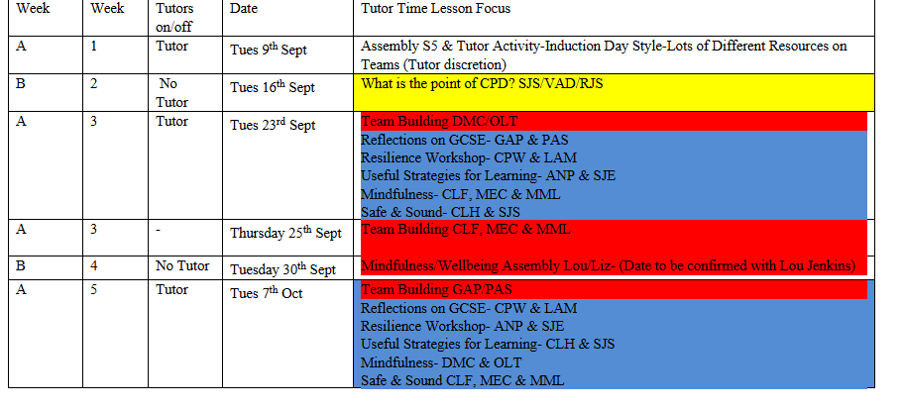
Year 12 CPD
VAD

Slide 12
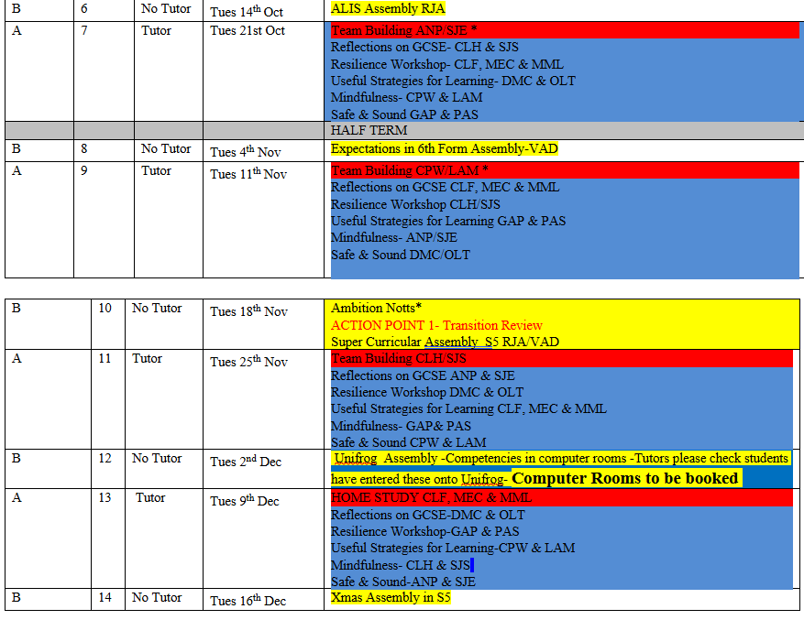
Year 12 CPD
VAD

Slide 13
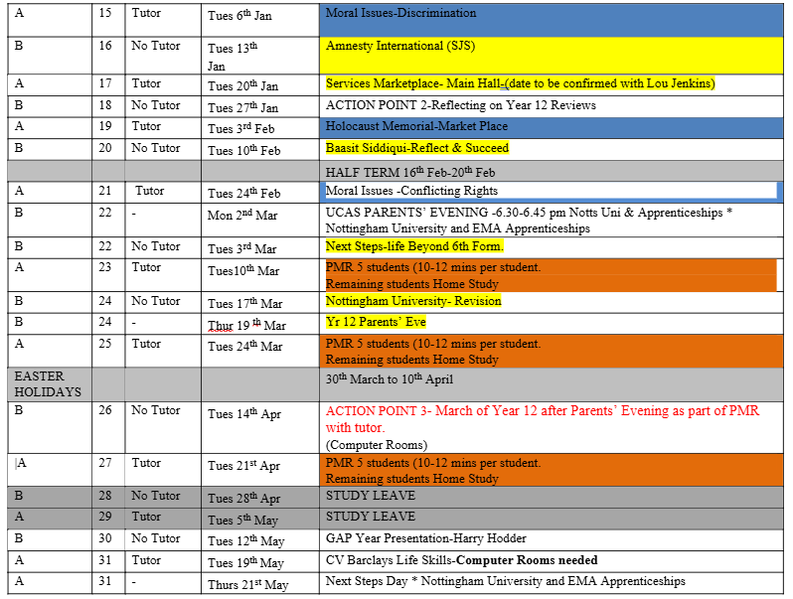
Year 12 CPD
VAD

Slide 14
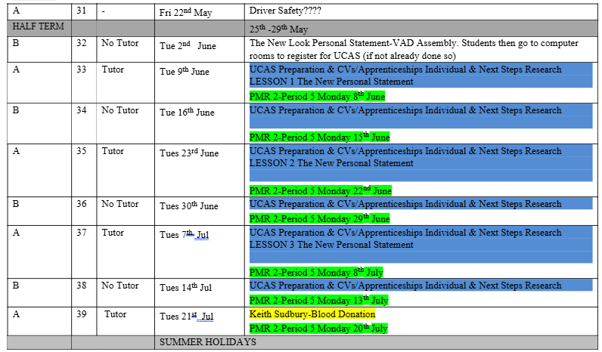
Year 12 CPD
VAD

Slide 15
6th Form Mindset
SJS
Vision
Effort
Systems
Practice
Attitude
Notes:
Vision – knowing what they want to achieve – having goals. Much easier to motivate yourself if you know what you are doing it for.
Effort - Putting in the hours of proactive independent study. Not just ‘busy work’
Systems – organising their time and learning. Staying on top of notes – be their ‘future friend’.
Practice – using feedback to make improvements.
Attitude – react well to setbacks – showing resilience and grit.

Slide 16
The Science of being a Sixth Form Parent
SJS
Communicate regularly.
Try to see failure as enhancing.
Revising to music is less effective.
Sleep is important.
Mobile phones negatively affect performance.
Notes:
All references from The Science of Learning 2nd Edition Watson and Busch.
This is from a meta-analysis from 2015 of 37 studies involving 80,000 students. They found regular communication with parents helped to motivate students and nip problems in the bud. The Journal of Adolescent Health 2006 recommended doing this whilst eating together - it has been linked to enhanced motivation, engagement, optimism, self-esteem etc. Probably linked to 1, but at mealtimes communication can be more informal/low stakes (p27, 147)
This is from a Stanford University study in 2016. The children of parents who viewed failure as ‘enhancing’ (a learning opportunity) were more likely to develop resilient thought processes and succeed in the long run. (p37)
Applied Cognitive Psychology 2014 found those who revised in a quiet environment performed 24% better than those who listened to music with lyrics from an artist they liked. (p38)
Psychological bulletin 2009 Sleep helps memory, so every school night sleep is important to help what they have learned during the day to be remembered. In the run up to exams sleep is vital – more effective than cramming. (p62) The Journal of Nature (2013) found parents overestimate how much sleep their children are getting by up to 2 hours per night. We will talk to them about importance of sleep hygiene – having a set bed time and routine, cool room, avoiding caffeine and energy drinks. (p188)
Social Psychology 2014. The mere presence of their mobile phone in the room is shown to reduce attention, concentration and performance by 20%. This was regardless of age, gender, how much the student normally used the phone and how attached to it they said they were. (p64) Banning mobile phones in schools produces on average a 6.4% increase in exam results (p102)

Slide 17
Careers and UCAS
RJA
85%+ go to University
Increasing numbers looking at other options
UCAS parents information evenings
Links with local universities
Structured and effective process in place
More independence needed if looking at other options.

Slide 18
Attendance and Punctuality
RJA
Directly related to exam success (or failure!)
95% is the MINIMUM expectation
Also consider number of separate periods of absence
Poor attendance will result in students being asked to leave
Students should be in school by 8:35 each morning and 2:00 each afternoon.
Attendance and punctuality figures go onto reports and references

Slide 19
Attendance Procedures…
RJA
Notification of Absence Forms (available online from website and sent via email) – email to sixthform@littleover.derby.sch.uk with copies to relevant teachers.
Written evidence required (scan/photo fine) – link emailed.
For illness/emergency appointments etc. please ring Mrs Goodman (513219 ext 360) before 9:30am.
Signing in and out.
Communication.
See HANDBOOK (website)

Slide 20
Go4Schools and ParentPay
Both are ESSENTIAL for life in the 6th Form!
Students and Parents should have access to Go4Schools (homework, reports, key grades, attendance, timetables, cover work etc).
ictsupport@littleover.derby.sch.uk
Parents must also have ParentPay accounts set up (trips, revision books, food payments etc).
ppay@littleover.derby.sch.uk

Slide 21
Monitoring and Intervention
RJA
TARGET grades generated this term
PREDICTED grades go onto reviews and reports
Reviews in December and July (parental contact if concerns)
Parents’ Evening (March 26th)
Exams – early May (crucial for UCAS grades)
Reports in July
Traffic light system on tracking spreadsheet
Initial intervention with student – then with parents if necessary
Ongoing monitoring throughout the year
Go4Schools (attendance, grades, homework, reviews, reports)

Slide 22
Post 16 Bursary
RJA
Initial letter already given to students
Eligibility explained in the letter
Read the pack carefully – must provide evidence.
Email us if you have questions
Used for supporting study – not cash to students.
Deadline for applications and evidence – Friday 26th September

Slide 23
Pastoral System and Wellbeing
RJA
Tutor contact every day (AM Reg) + CPD period
Vital relationship – keep us informed
Head and Deputy Head of 6th Form
Senior 6th Form Tutor
Wellbeing coaches

Slide 24
Dress Code
RJA
Smart and businesslike – fit the ethos of the school and 6th form.
We do not insist on suits but they are always a safe bet!
Students may be sent home if not dressed appropriately.
See handbook for full details.

Slide 25


Slide 26


Slide 27
Work Experience…
All post 16 students are now expected to complete activities that prepare them for employment such as work experience placement.
Full details of the policy and procedures relating to work experience are on the website.
We encourage students to arrange work experience in holidays where possible but will authorise absence if necessary.
Some enrichment options are accepted as alternatives to work experience placement…..

Slide 28
Enrichment Programme
RJA
Duke of Edinburgh Gold**
Extended Project Qualification
Sri Lanka Expedition**
Student Kitchen
Indoor Climbing
Debating Club
In Class Support
Learning Mentors
** - Accepted as alternative to work experience
Pottery making
Sign Language
Museum of Making
Critical Thinking
UK Space Challenge
Self Defence
Golf

Slide 29
LCS 6th Form Facilities
RJA
Available to 6th Form students from 7:30am-5:30pm daily.
Available during exam leave but NOT school holidays.
Space for 80 students in study rooms (some supervision) including 50 computer stations.

Slide 30
Key Dates
Thursday 18th September – Sri Lanka and Gold Duke of Edinburgh Information Evening.
Mid October – Informal settling In Reviews (we will contact you if concerns are raised)
INSET Day – 24thOctober
WC 1st December - Full Interim Review (on Go4Schools – we will contact you if concerns are raised).
INSET Day 1st December
25th Feb – Year 12 UCAS and Apprenticeships Parents’ Evening
26th March – Parents’ Evening (4:30-7:00)
INSET Day 22nd April
27th April – 9th May – Year 12 transition exams (study leave for first week)
21st and 22nd May – Next Steps Days (post 18 planning, in school but off timetable)

Slide 31
Any questions?
RJA

